Slide 1

Unconscious Bias
Conference of Colleges Diversity Fund Project on special dietary requirements of BAME and observant religious students
The Listening Brain, Source: The Wellcome Institute

Slide 2
Religion and belief
Module 1

Slide 3

Your Name Here
Your College Here

Slide 4

INTRODUCTIONS
Your name and what you do
How long you have done it?
Why are you here?
Why do you want to be a trainer on this subject?
Notes:
4

Slide 5


Domestics
Respectful use of phones please
Emergency evacuation
Toilets
Refreshments

Slide 6


Slide 7
An Overview
World Religions

Slide 8
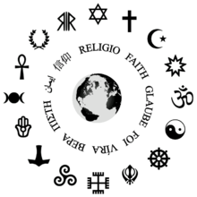
How many religions are there?
There are said to be over 4,200 religions in the world
However the Great Britain Census is only interested in 8 categories:
  Buddhist
  Christian
  Hindu
  Jewish
  Muslim
  Sikh
  No Religion
  Other Religion
Notes:
The symbols are: Judaism, Christianity, Islam, Baha’i Faith, Hinduism, Taoism, Buddhism, Sikhism, Slavic neopaganism, Celtic polytheism, Heathenism (German paganism), Semitic neopaganism, Wicca, Kemetism (Egyptian paganism), Hellenism (Greek paganism), Italo-Roman neopaganism.
We are concentrating on the first 7 categories and have plucked Jains and Rastafarians from the Other Religion category for the purposes of this training session as the religions we feel you are most likely to come into contact with that also have specific dietary requirements.
We do not know their exact numbers for Jains and Rastafariansim as their details are not collected as part of the census

Slide 9
Religion in Great Britain (2011 census)
Notes:
Christianity looks very healthy, but the Tearfund Survey in 2007 found that only 7% of the UK population felt they were practising Christians. 66% of the population (32..2 million) felt that they had no connection with the church. So many people describe themselves as Christian, despite non-attendance, because the UK culturally is Christian. The prime minister (Boris Johnson) is a typical example of a non-practising UK Christian, someone who is not a serious adherent to the faith, but nevertheless attends church when necessary. Jeremy Corbyn, the leader of the opposition, prefers to keep his religious views private, but has stated that he is not an atheist.
Jedi census phenomenon
In the 2001 census, 390,127 individuals (0.7 per cent of total respondents) in England and Wales self-identified as followers of the Jedi faith. This Jedi census phenomenon followed an internet campaign that claimed, incorrectly, that the Jedi belief system would receive official government recognition as a religion if it received enough support in the census. An email in support of the campaign, quoted by BBC News, invited people to "do it because you love Star Wars ... or just to annoy people". The Office for National Statistics revealed the total figure in a press release entitled "390,000 Jedi there are".

Slide 10
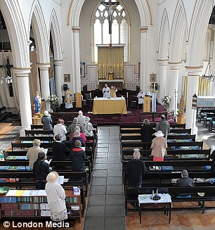
This means that …
According to the Tearfund Survey of 2007 approximately 7% of Christians will be regular church attenders
That means 2,335,000 regular church goers as opposed to the 33,365,000 people who see themselves as Christian
Observant Christians tend to have an older age profile 22% aged 65 and over.
Notes:
When it was first built in 1849 had regular congregations of 1,000. Now only 12 people attend regularly.

Slide 11
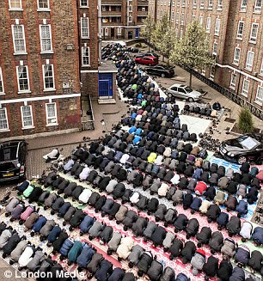
All Change?
In the 2011 Census 7.6% of the UK population gave their religion as different to Christianity
Muslims 5% of the UK population
Largest religious group after Christianity
Muslims tend to have a younger age profile 48% under 25.
Notes:
The first photo shows St Mary’s Church in Cable Street, this photo is of worshippers at Friday midday prayers outside a mosque in Spitalfields. Both places of worship are in East London.
The mosque was only built with space for 100 inside, so everyone else has to pray outside.
It is a regular feature of migrant groups to attend a place of worship in a new country. Look at the increase in congregations at Catholic churches when Polish and Latvian people first came to the UK in large numbers in 2007 onwards.

Slide 12
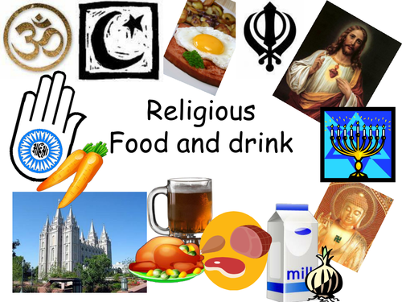
Food Glorious Food
In this session we concentrate on the dietary requirements of observant religious people:
How this makes life challenging
How this makes life interesting

Slide 13
Fiendishly hard quiz
Work Individually or in pairs!
See how many questions you can answer

Slide 14
Who is the customer?
University of Oxford

Slide 15
Who are my customers?
Around the diagram, write the types of people you come into contact with, who you regard as your customers
YOU

Slide 16
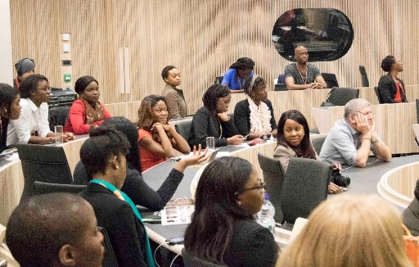
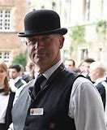
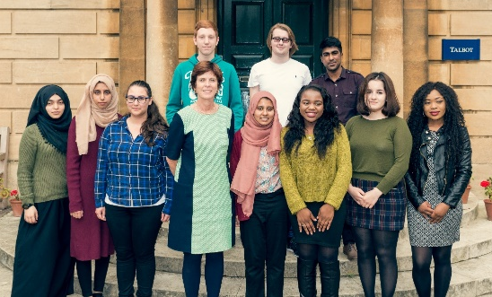

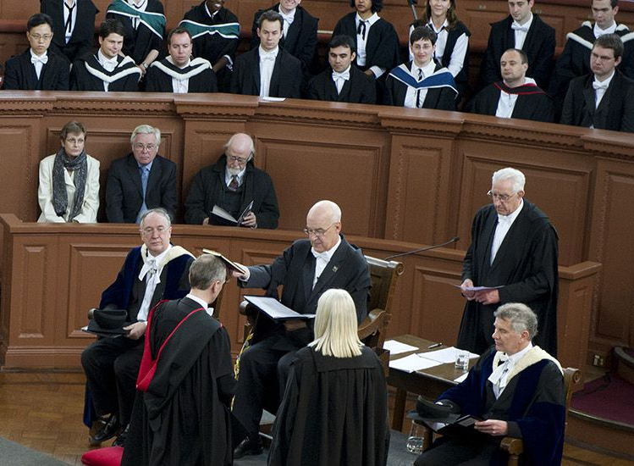

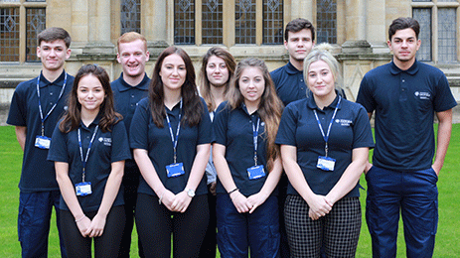
External and internal customers
Conferences
College Staff
Students
YOU
Admin Staff
Academic Staff
Language Schools
Maintenance Staff

Slide 17
Our customers include:
People who use our services
People acting on behalf of people who use our services
Staff in the University – our internal customers
Contractors working for the University – our external customers
Other stakeholders

Slide 18
What is a customer?
A customer is anyone who comes to you, or relies on you, for a service or for information
Even if you do not provide a service directly to a customer, you will be providing a service to someone who does

Slide 19
On the topic of your customers
How aware are you of how well you treat your colleagues?
Do you provide the same level of professionalism and care to all your customers?
The approaches we use with our colleagues should mirror those we use with other customers

Slide 20
Importance internal customers
Great customer service means delivering a service to everyone we come into contact with, on top of the job we’re actually employed to do
Treating your colleagues with great customer care and respect is as important as it is with other customers
“It's almost impossible to provide good external service if you and your organisation are not providing good internal service."
Benjamin Schneider, University of Maryland

Slide 21
…and the equality act
Customer Care

Slide 22
The Equality Act and Customer Care
It is a key part of the legal framework that underpins the way the University provides its services
It sets out everyone’s right to be treated as an individual and with respect and dignity
It requires that university education services must be fair and meet the needs of everyone

Slide 23
The Equality Act 2010
Prohibits discrimination from:
employers
businesses and organisations which provide goods or services like banks, shops and utility companies
health and care providers like hospitals and care homes
someone you rent or buy a property from like housing associations and estate agents
Universities, colleges and schools
transport services like buses, trains and taxis
public bodies like government departments and local authorities.

Slide 24
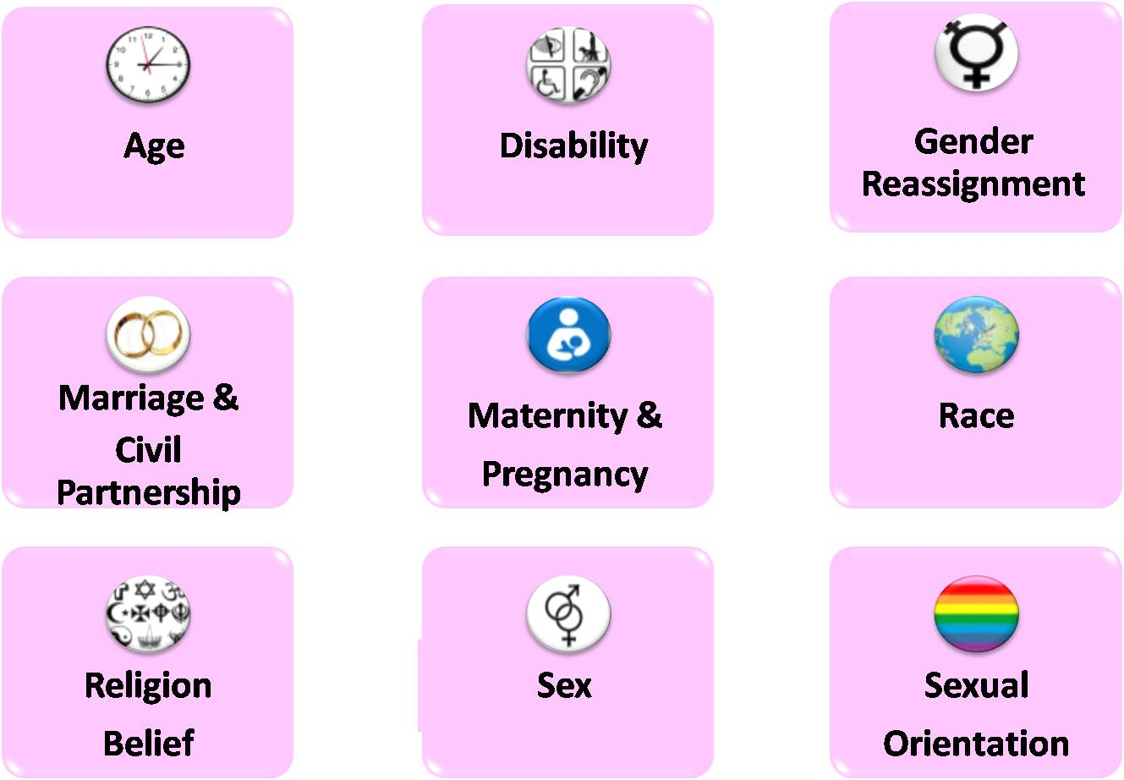
9 Protected Characteristics
The concept of “protected characteristics” brings all the existing protected grounds of discrimination into one place

Slide 25
Types of unlawful treatment
Being treated unfairly because of one or more protected characteristic is unlawful
If you’re treated unfairly because someone thinks you belong to a group of people with a protected characteristic, this is also unlawful discrimination.

Slide 26

The Equality Policy provides for an inclusive environment, which:
'promotes equality, values diversity and maintains a working, learning and social environment in which the rights and dignity of all its staff and students are respected.'
It also provides that no student or member of staff will be treated less favourably on grounds which include religion and belief.

Slide 27
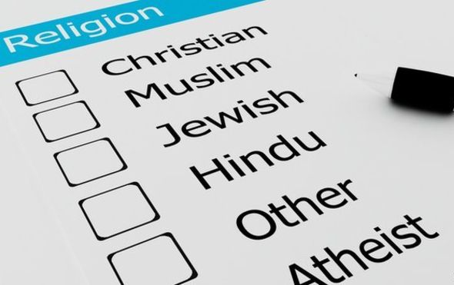
What is a religion or belief?
The definitions of religion and belief are:
religion:
any religion or reference to religion, including a reference to a lack of religion
belief:
any religious or philosophical belief or reference to belief, including a reference to a lack of belief

Slide 28
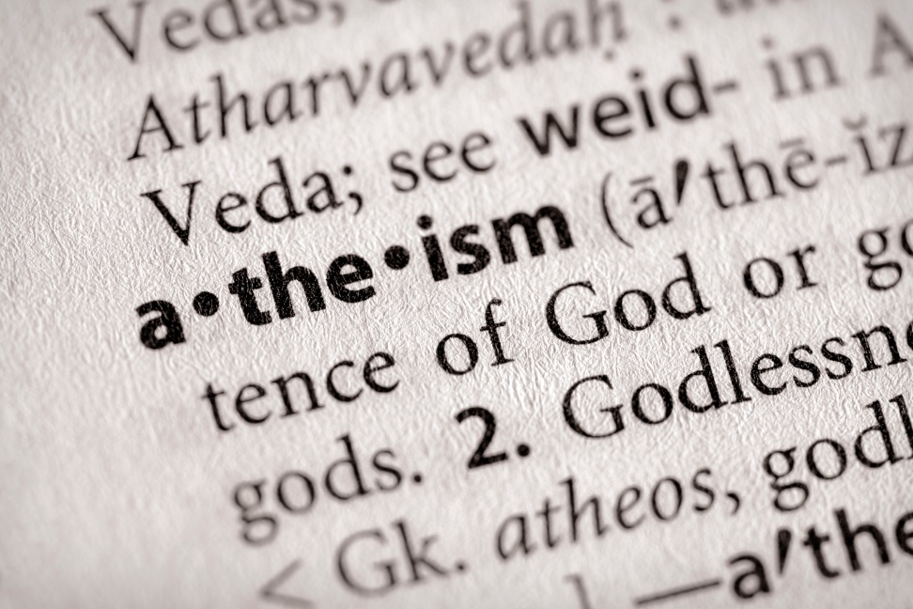
I Believe in Atheists
Religion or belief should be taken to mean the full diversity of religious and belief affiliations within the UK, including:
non-religious and philosophical beliefs such as:
Atheism
Agnosticism
Humanism

Slide 29
Islam
Catering for Religious Students and Staff

Slide 30

Halal
Eating as a form of worship
like prayer for strict Muslims.
You are meant to:
Eat for survival
To maintain good health
Eat to Live not Live to Eat

Slide 31

Halal vs Haram
Foods are classified in the Quran as either:
Halal - lawful or permitted, or
Haram - unlawful

Slide 32

3 Helpful Guidelines!
In Islam there are three important guidelines that relate to selecting food and drink:
Whether or not the consumption of the food is prohibited by Allah?
Whether the foodstuff is obtained through Halal or Haram means
Whether or not the material is harmful to health

Slide 33
HALAL (lawful) FOODS
Products made from the following substances are Halal unless they contain or come into contact with a Haram substance
All plants and their products
Certified Halal meat, poultry, game birds and animals
All water creatures, fish, crustaceans and molluscs
Eggs from acceptable birds only. (See unacceptable birds)
Rennet from certified Halal slaughtered calves
Non animal rennet (NAR, culture)
Gelatin produced from certified beef skins and/or bones
Animal ingredients certified Halal

Slide 34
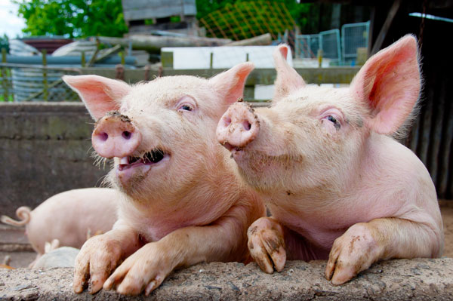
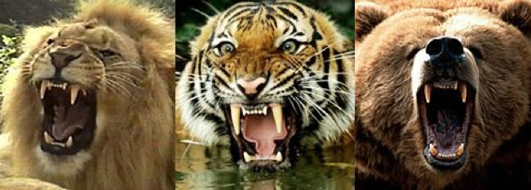
HARAM (unlawful) FOODS 1
Pork – including all by-products
Insects considered ugly or filthy such as worms, lice and flies
Animals with fangs such as lions and tigers and bears
Birds that have talons with which they catch their prey such as owls and eagles
Amphibians
Dogs
Notes:
More Haram:
Animals which Islam encourages people to kill i.e. Vermin such as scorpions, centipedes and rats. Bee!
Animals that contain toxins, poisons (especially fish). Crocodiles. Poisonous and intoxicating plants and their by-products i.e. no marijuana, or opium – or Hash Brownies
Carrion

Slide 35
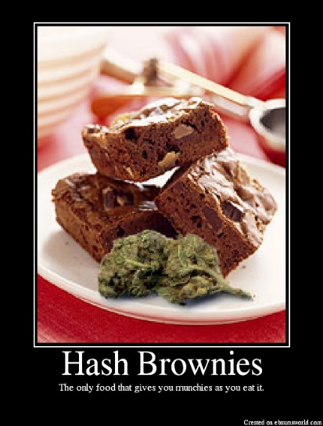
HARAM (unlawful) FOODS 2
Stolen foods and foods detrimental to spiritual and mental health such as alcoholic drinks and drugs are also prohibited.

Slide 36
But what about…?
Meat alternatives are Halal regulated
Some things start off Haram, but through changes in production become Halal
These include:
  Food Additives
  Gelatin
  Emulsifiers
  Rennet

Slide 37
The Thing to Remember is
Halal ingredients
Must not:
  Be mixed, or
  Come into contact with Haram materials
During
  Storage,
  Transport
  Cooking
For a food to remain Halal
Utensils
Processing Equipment
Manufacture
Storage
Should be cleansed in accordance with Islamic law.

Slide 38
Muslim Festival and Holy Days
Ramadan (Fasting)
Eid al Fitr ~ Ramadan ends (Fasting)
Eid al Adha (Fasting)
Mawlid an Nabi
Notes:
https://www.happy.co.uk/media/1392/cultural-planner-2019-online.pdf

Slide 39
Fine Dodgy Awful
The aim of this exercise is to give you the opportunity to explore some of the decisions that might be made within the context of catering and how they might affect Staff and Students who are Religious observant.
In your small groups consider each of the situations listed below, discuss whether they are:
Fine | Perfectly OK for everyone
Dodgy | Might be difficult for some students and staff
Awful | Completely inappropriate in a professional kitchen

Slide 40
Break
Be back in 15 minutes!

Slide 41
Judaism/kASHRUT
Catering for Religious Students and Staff

Slide 42
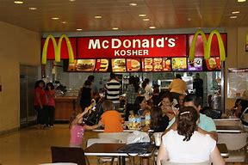
Kashrut or Kosher
Kashrut is a set of Jewish Dietary Laws
Kosher is the Yiddish word commonly used
It means “Fit” or “Proper”
It’s used to describe something that is correct, especially food
Kosher food is suitable for a Jewish person to eat

Slide 43
The Torah says
Land Animals
Only animals that chews the cud and has cloven (split) hooves
Water Animals
All forbidden unless Fish that have fins and scales
Birds
No Birds of Prey
No Scavengers
No Birds with webbed feet
Only certain kinds of animal considered inherently Kosher
For those of you without a Torah look in the Bible - Leviticus 11

Slide 44
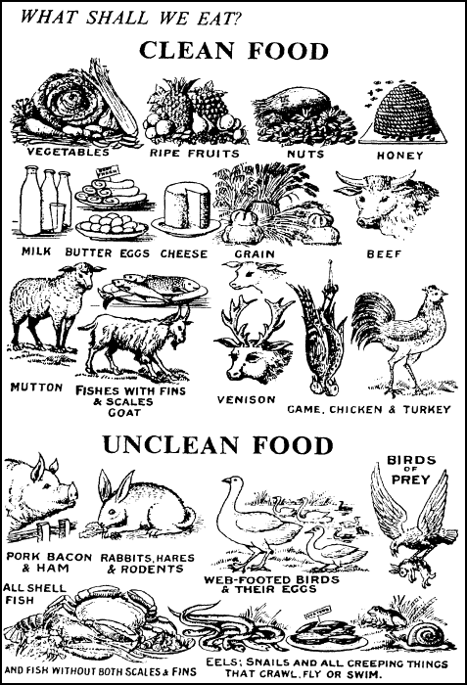
What Shall We Eat?
Notes:
Kashrut is a set of Jewish religious dietary laws. Food that may be consumed according to halakha is deemed Kosher which means “Fit” or Proper”. We will use Kosher for our training as that is the term most people are familiar with.
Forbidden Meat
Mammals: Carnivores. Animals that do not chew the cud (e.g. Pigs). Animals that do not have cloven hooves (e.g. Camels, Hares and Horses)
Birds: Birds of prey: scavengers; There is dispute on whether ducks, geese, swans are clean or unclean – most Jewish will eat them a very few will not.
Reptiles: All
Amphibians: All
Water Animals: All non-fish. Among fish, all those that do not have both fins and scales.
Insects: All - Except for an unidentifiable Kosher Locust
So, to be Kosher a mammal has to both chew the cud and have cloven hooves e.g. cows, goats and sheep.
These laws are updated and as recently as 2008 a rabbinical ruling added giraffes to the list. However, there is unlikely to be a rush on giraffe meat as they are very difficult to restrain, know where on the neck to cut and slaughter and also, they are endangered animals.
If you want the complete list here it is:
Deutoronomy 14
3.Thou shalt not eat any abominable thing. 4These are the beasts which ye shall eat: the ox, the sheep, and the goat, 5The hart, and the roebuck, and the fallow deer, and the wild goat, and the pygarg, and the wild ox, and the chamois. 6And every beast that parteth the hoof, and cleaveth the cleft into two claws, and cheweth the cud among the beasts, that ye shall eat. 7Nevertheless these ye shall not eat of them that chew the cud, or of them that divide the cloven hoof; as the camel, and the hare, and the coney: for they chew the cud, but divide not the hoof; therefore they are unclean unto you. 8And the swine, because it divideth the hoof, yet cheweth not the cud, it is unclean unto you: ye shall not eat of their flesh, nor touch their dead carcase.
9These ye shall eat of all that are in the waters: all that have fins and scales shall ye eat: 10And whatsoever hath not fins and scales ye may not eat; it is unclean unto you.
11Of all clean birds ye shall eat. 12But these are they of which ye shall not eat: the eagle, and the ossifrage, and the ospray, 13And the glede, and the kite, and the vulture after his kind, 14And every raven after his kind, 15And the owl, and the night hawk, and the cuckow, and the hawk after his kind, 16The little owl, and the great owl, and the swan, 17And the pelican, and the gier eagle, and the cormorant, 18And the stork, and the heron after her kind, and the lapwing, and the bat. 19And every creeping thing that flieth is unclean unto you: they shall not be eaten. 20But of all clean fowls ye may eat.
21Ye shall not eat of any thing that dieth of itself: thou shalt give it unto the stranger that is in thy gates, that he may eat it; or thou mayest sell it unto an alien: for thou art an holy people unto the LORD thy God. Thou shalt not seethe a kid in his mother's milk.

Slide 45
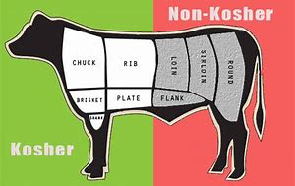
Meat
Mammals and Birds slaughtered in the prescribed manner
Their byproducts except:
Blood
Chelev (Suet fat)
Gid Hanasheh (Sciatic Nerve – Basically the rear end of the animal is not used)
Notes:
Blood The blood of kosher animals is removed through salting with special procedures for the liver, which is rich in blood.
Particular Fats Chelev are forbidden. These are found around the organs inside an animal. In the UK we make these fats into Suet which we use for cooking and baking.
The Twisted Nerve Gid Hanasheh (the Sciatic Nerve) is not eaten and where it is difficult to remove that portion of the animal is not used and will be sold to non-Jewish butchers. What this means is that most of the rear of an animal is not used even if Kosher e.g. no rump steaks, no Leg of Lamb

Slide 46
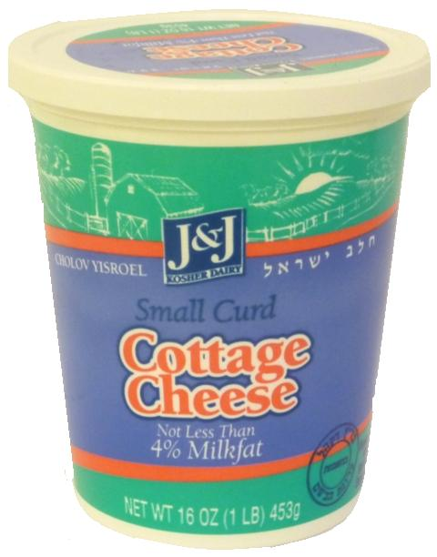
Dairy
Must come from a kosher animal
All ingredients must be kosher:
  Rennet in hard cheese
  Gelatine in yogurts
Made using kosher equipment

Slide 47

Pareve = Neutral
All items that grow from the ground
Eggs
Fish
Rennet from a kosher animal to make kosher cheese
Gelatine from a kosher animal
Agar-Agar and Carrageenan (Gelatine-like products)

Slide 48
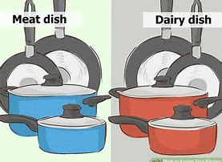
Milk and Meat
“Thou shalt not seethe a kid in his mother's milk.”
Exodus 23:19
It is necessary to keep all dairy and meat foods completely separate
Separate sets of dishes and cooking utensils
Some Jewish people will have separate fridges, worksurfaces, or even kitchens to keep meat and dairy separate
Notes:
“Thou shalt not seethe a kid in his mother's milk.” Is repeated three times in the Old Testament of the Bible – Exodus 23:19; Exodus 34:26 and Deutoronomy 14:21. this means amongst other things - No eating cheeseburgers!
Milk and meat in Jewish law
Mixtures of milk and meat are strictly forbidden according to Jewish law. This dietary law is mentioned three times in the Talmud (Old Testament of the Bible). This is all permitted meat including chicken and other domestic fowl.
For example, what this means is NO:
Meat Feast Pizzas
Cheeseburgers
Chicken Kiev
Butter on your sandwiches if you are having meat
Hollandaise, Bearnaise or Parsley Sauces in fact any sauce you intend to put on a meat dish that uses dairy in its production
Fish and dairy are slightly different, most communities allow the use of butter when cooking fish.

Slide 49
Jewish Festival and Holy Days
Purim
Pesach (Passover)
Rosh Hashanah
Hanukkah
Notes:
https://www.happy.co.uk/media/1392/cultural-planner-2019-online.pdf
Purim (Also called the Festival of Lots)
Commemorates the saving of the Jewish people from Haman, the vizier to King Ahasuerus (probably King Xerxes) of the Achaemenid Persian Empire. Haman had planned to kill all the Jews as recounted in the Book of Esther. Probably some time in the 4th century BCE.
It involves:
Exchanging gifts of food and drink
Donating charity to the poor known
Eating a celebratory meal
Public recitation of the Scroll of Esther, usually in synagogue
Reciting additions to the daily prayers and the grace after meals
Pesach (Passover)
One of the most widely known and celebrated Jewish holidays. It commemorates God saving the Israelites from slavery in Egypt by visiting the 10 plagues. The last was the death of the First Born. The Israelites were told to daub the blood of a slaughtered sheep on the lintels and door posts to ensure the demonic forces didn’t enter. There was also a ritual meal Seder to be eaten with Matzo Bread (an unleavened flatbread) prepared in readiness for a quick getaway.
Rosh Hashanah (The Jewish New Year)
This is currently the year 5775 in the Jewish calendar
It’s normally a two-day celebration which involves going to synagogue, festive meals with symbolic foods one of which is apples dipped in honey – hoping to evoke a sweet New Year
Hanukkah (Chanukah)
Is an eight-day, wintertime “Festival of Lights” celebrated with a nightly menorah lighting, special prayers and fried foods.
The word means dedication, as it celebrates the rededication of the Holy Temple.

Slide 50
Fine Dodgy Awful
The aim of this exercise is to give you the opportunity to explore some of the decisions that might be made within the context of catering and how they might affect Staff and Students who are Religious observant.
In your small groups consider each of the situations listed below, discuss whether they are:
Fine | Perfectly OK for everyone
Dodgy | Might be difficult for some students and staff
Awful | Completely inappropriate in a professional kitchen
Notes:
1) The main meat dishes of the day are Beef Stroganoff and Chicken Kiev
Dodgy/Awful - Definitely not kosher
Milk and meat in Jewish law
Mixtures of milk and meat are strictly forbidden according to Jewish law. This dietary law is mentioned three times in the Talmud (Old Testament of the Bible). This is all permitted meat including chicken and other domestic fowl.
2) As a change from oxtail soup you serve Lobster Bisque
Dodgy/Awful – Let’s hope it’s only for one day!
Forbidden Meat
Water Animals: All non-fish. Among fish, all those that do not have both fins and scales. Definitely NO Lobster
3) A Jewish student is told the chicken is Halal “Won’t that do?”
Awful Kosher and Halal are not inter-changeable.
Can Observant Jews eat Halal?
No. the process for the kosher slaughter of meat products have many more requirements that halal slaughter does not.
So, a Jewish person keeping kosher, will not eat halal meat.
4) A student asks for the Surf and Turf to be served separately on two plates
Fine – It’s perfectly ok for a student to request that their food is served this way.
Meat and Fish Together
Generally speaking, this is allowed at the same meal but at different times i.e. a fish course followed by a meat course, but not on the same plate.
There does not appear to be a law in the Kashrut about this, it’s more custom and practice.
5) At a mixed event that is serving alcohol someone asks for kosher wine?
Fine/Dodgy – It’s perfectly okay for someone to ask for it, but dodgy if you don’t have any.
Kosher Wine is produced under the supervision of Sabbath-observant Jews who handle the entire winemaking process from the crushing of the grapes to until the wine is bottled. Any ingredients including finings (items used to refine and clear the wine) must be kosher. Once produced it would normally be given a hechsher (seal of approval).
The demand for kosher wine has grown a quick search and you’ll find it online at Tesco, Sainsbury’s, Waitrose and Amazon
6) Somebody complains that the Spotted Dick and Custard isn’t Kosher
Fine/Awful – What kind of Suet did you use? What do you mean you didn’t use suet?
Particular Fats Chelev are forbidden. These are found around the organs inside an animal. In the UK we make these fats into Suet which we use for cooking and baking.
Vegetarian suet is available.

Slide 51
Sikhism
Catering for Religious Students and Staff

Slide 52

Sikhs believe that
There is only one God
God is without form, or gender
Everyone is equal before God
A good life is lived:
  As part of a community
  Living honestly
  Caring for others
Empty religious rituals and superstition have no value

Slide 53
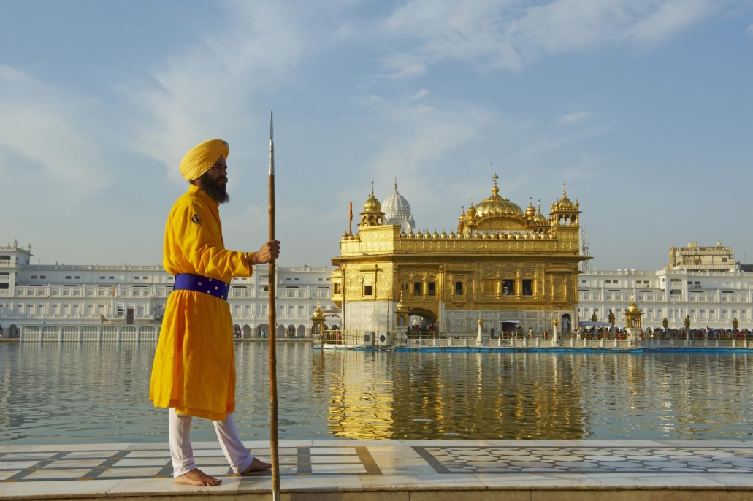
Sikh code of conduct on diet
The most important thing in Sikhism is the internal religious state of the individual
According to the Sikh code of conduct or Rehat Maryada, Sikhs are free to choose whether or not to include meat in their diet

Slide 54
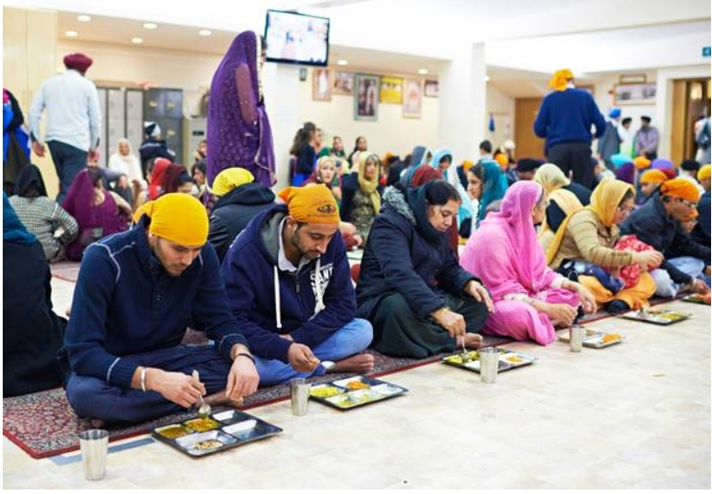
Place of worship: Gurdwara
Gurdwaras provide:
Langar (free kitchen)
The langar is run by volunteers, who can be male or female
It is a privilege to help
Serves only vegetarian food, to make it inclusive of all faiths
Notes:
Now regularly used by the Trussell Trust to feed people – overseas students, homeless people.

Slide 55
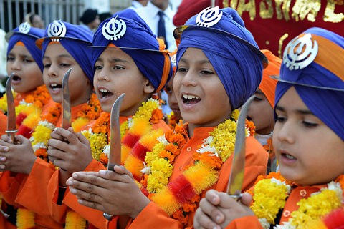
The 4 transgressions
Dishonouring the hair
Eating the meat of an animal slaughtered the Muslim way (Kutha)
Cohabiting with a person other than one’s spouse
Using tobacco
Notes:
Kutha also includes meat slaughtered the Jewish (Kosher)

Slide 56
Sikh Festival and Holy Days
Baisakhi (Vaisakhi)
Diwali
Guru Nanak Gurpurab
Notes:
https://www.happy.co.uk/media/1392/cultural-planner-2019-online.pdf
Baisakhi
Commemorates the formation of Khalsa panth of warriors. The first community to consider Sikhism as it’s faith.
Also celebrates the Solar New Year.
People bather in rivers and lakes before visiting local Gurdwaras. There are fairs and people socialise and share festive foods.
Diwali
Possibly the best known and most popular celebration from the Indian sub-continent and common to Hindus, Jains as well as Sikhs
Diwali symbolises the spiritual “victory of light over darkness, good over evil and knowledge over ignorance”.
During the celebration temples, homes and shops are brightly illuminated.
Generally, it lasts for about 5 days.
Guru Nanak Gurpurab
Celebrates the birth of the first Sikh Guru. It is the most sacred of Sikh festivals.

Slide 57
HINDUISM
Catering for Religious Students and Staff

Slide 58

Oldest and Still Going Strong
Hinduism promotes
Natural Simple Living
As a path to
Physical
Spiritual

Slide 59
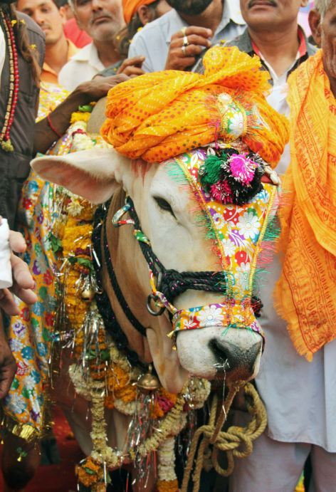
Diet and Belief
Hindu diets varies by region
Some are strict vegetarians
Some eat meat
Most are lacto-vegetarian and so don’t eat
  Meat
  Poultry
  Fish
  Eggs
Sacred Cows!
Notes:
Diet in Hinduism
varies with its diverse traditions. The ancient and medieval Hindu texts strongly prohibit eating meat, and they recommend non-violence against all life forms including animals because they believe that it minimizes animal deaths. Many Hindus prefer a vegetarian or lacto-vegetarian lifestyle, and methods of food production that are in sync with nature, compassionate, and respectful of other life forms as well as nature.
The diet of many Hindus includes eggs, fish or certain other meat. For slaughtering animals and birds for food, meat-eating Hindus often favour a quick death style preparation of meat since Hindus believe that this method minimizes trauma and suffering to the animal. Ancient Hindu texts describe the whole of creation as a vast food chain, and the cosmos as a giant food cycle.
Hindu mendicants (sannyasin) avoid preparing their own food, relying either on alms or harvesting seeds and fruits from forests, as this minimizes the likely harm to other life forms and nature.
Sacred Cows
Because most Indians consider the cow as a sacred or holy animal. With Hinduism as the main religion for most Indians, cows are thought of as a great symbol or representation of the Earth. Cows are deemed as great providers without asking for anything in return. This is what makes cows very sacred in the practice of Hinduism.

Slide 60
Hindu Festival and Holy Days
Holi
Krishna Janmashtami
Dussehra
Diwali
Notes:
https://www.happy.co.uk/media/1392/cultural-planner-2019-online.pdf
HOLY DAYS
Holi
(Also known as the Festival of Spring, Festival of Colours, Festival of Love)
Signifies the arrival of spring and the end of winter and interestingly the Blossoming of Love.
There are lots of colours liberally shared, smeared, sprayed lots of water balloons and water pistols.
People share food and drink including a cannabis drink called bhang.
Krishna Janmashtami
Celebrates the birth of Krishna a major Hindu God.
The holiday is a 48-hour celebration. Some people will fast for the first day. Food tends to be prepared from milk and curds.
Dussehra
Many people of the Hindu faith observe Dussehra through special prayer meetings and food offerings to the gods at home or in temples throughout India. They also hold outdoor fairs (melas) and large parades with effigies. The effigies are burnt on bonfires in the evening. Dussehra is the culmination of the Navaratri festival
Diwali
Possibly the best known and most popular celebration from the Indian sub-continent and common to Sikhs, Jains as well as Hindus.
Diwali symbolises the spiritual “victory of light over darkness, good over evil and knowledge over ignorance”.
During the celebration temples, homes and shops are brightly illuminated.
Generally, it lasts for about 5 days

Slide 61
Fine Dodgy Awful
The aim of this exercise is to give you the opportunity to explore some of the decisions that might be made within the context of catering and how they might affect Staff and Students who are Religious observant.
In your small groups consider each of the situations listed below, discuss whether they are:
Fine | Perfectly OK for everyone
Dodgy | Might be difficult for some students and staff
Awful | Completely inappropriate in a professional kitchen

Slide 62
BuddhisM
Catering for Religious Students and Staff

Slide 63
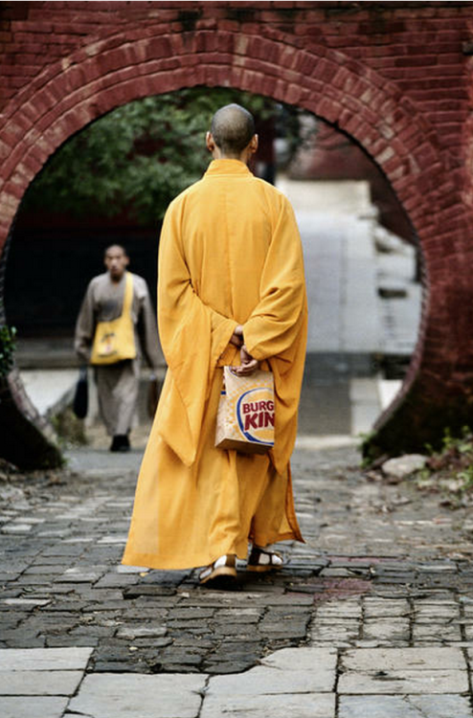
5 Basic Codes
Followers of Buddhism should abstain from:
  Harming Living Beings
  Stealing
  Sexual Misconduct
  Lying
  Intoxication

Slide 64
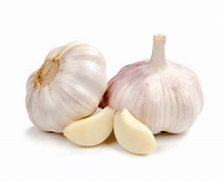
And Diet?
There are no set restrictions
Some interpret “Do No Harm” to mean following a “lacto-vegetarian” diet
Some refrain from:
  Garlic
  Allium Chinense
  Asafoetida
  Shallot
  Mountain Leek
As these excite the senses if eaten raw

Slide 65
Buddhist Festival and Holy Days
Bodhi Day
Nirvana Day (Mahayana)
Magha/Sangha
Notes:
https://www.happy.co.uk/media/1392/cultural-planner-2019-online.pdf
Bodhi Day
The day the Buddha (Siddhartha Gautama) experienced enlightenment.
Some Buddhists celebrate with a traditional meal of tea, cake and readings
Nirvana Day
This is an annual Buddhist festival that remembers the death of the Buddha when he reached Nirvana at the age of 80.
Nirvana is believed to be the end of the cycle of death and rebirth. Buddhism teaches that Nirvana is reached when all want, and suffering is gone.
Celebrated by more readings and NO tea and cake
Magha Puja
Māgha Pūjā is the second most important Buddhist festival, celebrated on the full moon day of the third lunar month in Cambodia, Laos, Thailand, Sri Lanka.
It celebrates a gathering that was held between the Buddha and 1,250 of his first disciples. On the day, Buddhists celebrate the creation of an ideal and exemplary community, which is why it is sometimes called Sangha Day.
The Sangha being a Buddhist community,
More readings and tea and cake a distant memory!

Slide 66
Jainism
Catering for Religious Students and Staff

Slide 67
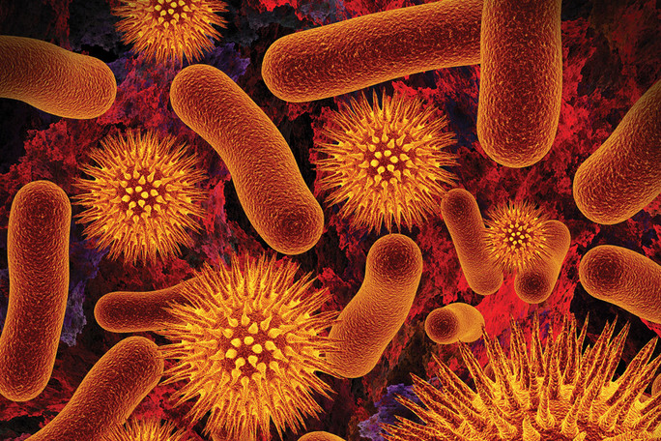
Conquering Your Passions
This means that to save your own soul you have to protect the souls of others
Ahimsa = Non-Violence
Vegetarian
Definition of “living beings” can be extended to Bacteria and Microorganisms

Slide 68
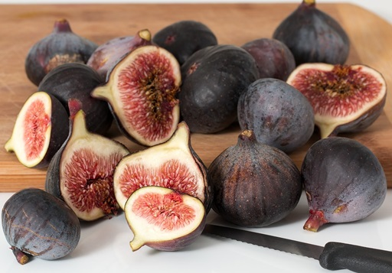
Really Strict
Harvesting some foods harms living beings and is avoided
Eating during the daylight hours
The promise of life inherent should not be sacrificed to the lust of the palate = no multi-seed plants
Level of strictness varies from person to person

Slide 69

Even Stricter Than Vegans
Avoid:
  All animal flesh
  Eggs
  Multi-seeded plants
  Honey
  Onions and Garlic
  Alcohol
  Potatoes and Root Vegetables
Notes:
It is unclear how far the multi-seeded plant avoidance goes e.g. are strawberries and tomatoes okay?

Slide 70

Jain Festival and Holy Days
Paryushana
Diwali
Notes:
https://www.happy.co.uk/media/1392/cultural-planner-2019-online.pdf

Slide 71
Fine Dodgy Awful
The aim of this exercise is to give you the opportunity to explore some of the decisions that might be made within the context of catering and how they might affect Staff and Students who are Religious observant.
In your small groups consider each of the situations listed below, discuss whether they are:
Fine | Perfectly OK for everyone
Dodgy | Might be difficult for some students and staff
Awful | Completely inappropriate in a professional kitchen

Slide 72
Rastafari
Catering for Religious Students and Staff

Slide 73

Close to Nature
Rastafari philosophy
  Close to Nature
  Respect all forms of life
Therefore:
  Mostly Veggie
  Eat Fish
  Little or no meat
  No Pork
  No Shellfish
Notes:
Rastafari is a young, Africa-centred religion which developed in Jamaica in the 1930s, following the coronation of Haile Selassie I as King of Ethiopia in 1930.
Rastafarians believe Haile Selassie is God and that he will return to Africa members of the black community who are living in exile as the result of colonisation and the slave trade.
Rastafari theology developed from the ideas of Marcus Garvey, a political activist who wanted to improve the status of fellow blacks.
There are approximately one million worldwide adherents of Rastafari as a faith. The 2001 census found 5,000 Rastafarians living in England and Wales.

Slide 74
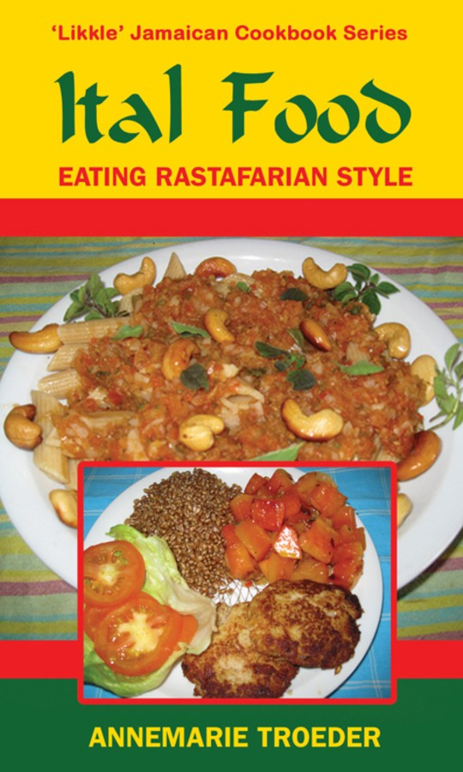
Naturally Ital
Ital is an eclectic form of cooking
In its strictest form excludes:
  Salt
  Sugar
  Preservatives
  Colouring
  Flavourings
  Anything Artificial
Notes:
Rastafari religious practice includes the ritual inhalation of marijuana, which is regarded as a sacrament, to increase their spiritual awareness; however, they avoid hard drugs such as cocaine or heroin
Rastafari follow strict dietary laws and abstain from alcohol.
Rastafari follow a number of Old Testament Laws
Follow patriarchal gender roles so there is a separate code of religious practice for women.
Rastafari are forbidden to cut their hair; instead, they grow it and twist it into dreadlocks
Rastafari place emphasis on what they regard as living naturally adhering to Ital dietary requirements which means eating clean and natural produce.
Rastafari try to refrain from the consumption of meat, especially pork
Some Rastafari object to be referred to as “Rastafarian”, or “Rastafarianism” – others do not.

Slide 75

Rasta Festival and Holy Days
Ceremonial Birthday of Haile Selassie
Groundation Day
Birthday of Haile Selassie
Marcus Garvey’s birthday
Crowning of Emperor Selassie
Notes:
https://www.happy.co.uk/media/1392/cultural-planner-2019-online.pdf

Slide 76
Fine Dodgy Awful
The aim of this exercise is to give you the opportunity to explore some of the decisions that might be made within the context of catering and how they might affect Staff and Students who are Religious observant.
In your small groups consider each of the situations listed below, discuss whether they are:
Fine | Perfectly OK for everyone
Dodgy | Might be difficult for some students and staff
Awful | Completely inappropriate in a professional kitchen

Slide 77
Christians
Catering for Religious Students and Staff

Slide 78
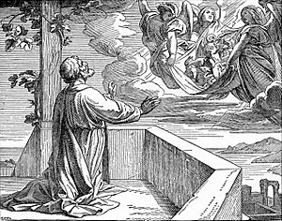
No Rules for Christians!
St Peter had a vision:
"saw a sheet containing animals of every description lowered from the sky.“
This was interpreted as a sign that gentiles who wanted to join what at this time was a Jewish sect did not have eat Kosher, amongst other things.
Notes:
The other things also included circumcision!

Slide 79
This meant Christians could eat from the Unclean Menu!
Notes:
It was basically a bribe and effectively threw Deuteronomy 14 in the bin. The only thing you weren’t allowed to do was eat the flesh of animals offered to other gods.

Slide 80
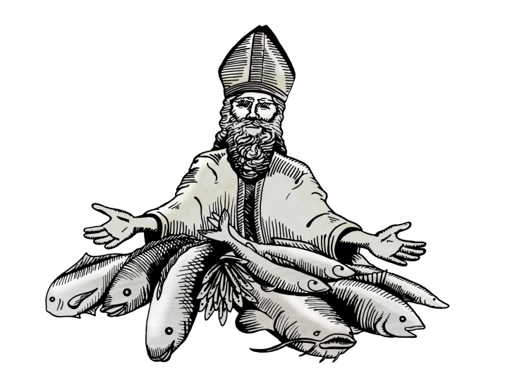
What about Fish on Fridays?
Christians were meant to fast on Fridays and on many other holy days and Lent
Fasting became not eating the flesh of warm-blooded animals
Fish are not warm-blooded so exempt
Why Friday?
  Jesus died on a Friday
So not a rule, more a hang over from a more religious time
Notes:
There were regular fast days when Christianity started usually Wednesdays and Fridays (at this time Jews often fasted on Monday and Thursdays)
What was a “Fast”? You had one meal a day, usually in the evening. NO Wine NO Meat at that meal.
The number of Fast days grew. Lent, the period of 40 days before Easter, became a time when congregations were urged to fast.
Over the centuries the ban on meat stayed, but it was generally agreed that fish were not meat as they were cold-blooded. So, you could eat fish on a fast day. Wednesdays stopped being fast days for most Christians. Fridays stayed as a fast day. Why? Because Jesus died on a Friday.
Although most Christians have stopped fasting the “Fish on Friday” has permeated throughout western culture. To the extent that the Filet-o-Fish was introduced by McDonalds when they noticed sales dipping on Fridays, because in strongly Catholic areas people wouldn’t eat meat.

Slide 81
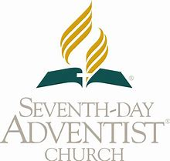
Seventh-Day Adventists
A Millennialist Protestant denomination
Founded in 1860s
In America
Name comes from:
Sabbath = 7th Day
Jesus returning to from Heaven = Advent

Slide 82


Seventh-Day Adventists
They live modest lives
Don’t Smoke
Don’t Drink
Prefer you don’t drink caffeine
They recommend a veggie diet
Will eat meat, but only sparingly from animals on the “Clean” menu
They live longer
7.3 years for
4.4 years for
Have fewer heart attacks
Less cancer
Their diet is a protection against Type 2 Diabetes
Notes:
There is a body of research know as Adventist Health studies that is on-going and stretches back to the 1960’s. Where other diets make claims 7DA can actually back it up.
https://en.wikipedia.org/wiki/Adventist_Health_Studies

Slide 83
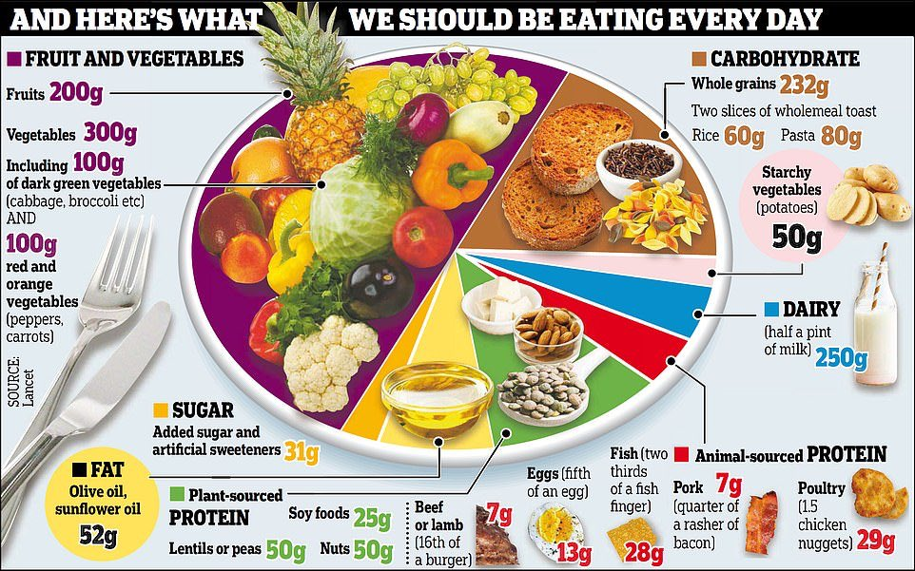
The Epitome of Healthy Eating
Notes:
Seventh Day Adventists eat what is recommended that we ALL should eat!
Note the absence of chocolate and cream cakes.

Slide 84
Christian Festival and Holy Days
Shrove Tuesday (Mardi Gras)
Maundy Thursday (end of Lent)
Good Friday
Easter Sunday
Christmas
Notes:
https://www.happy.co.uk/media/1392/cultural-planner-2019-online.pdf
Holy Days
Shrove Tuesday (Mardi Gras = Fat Tuesday)
This is the day before Lent starts. It was traditionally the day when one be shriven i.e. cleansed by confession, penance and absolution. In some cultures’ you’d have a big blow out before Lent in the UK e had pancakes. So Shrove Tuesday became known as Pancake Day. In Rio de Janeiro and New Orleans and elsewhere people have carnival. You’d have a fun time before everyone started fasting and giving thing up for lent.
Maundy Thursday
Marks the end of Lent, is part of Holy Week, and is immediately before Easter.
Easter (Good Friday to Easter Sunday)
Marks the death of Jesus Christ to his resurrection/rebirth.
Now traditionally celebrated with chocolate and Easter eggs which have no religious significance.
Easter comes from Eostre (pronounced Yo’ster), an ancient Anglo-Saxon goddess. During pagan times an annual spring festival was held in her honour.
Christmas
Celebrates the birth of Jesus Christ and is celebrated with presents and in less fruitful times as a period of indulgence.
No-one knows exactly when Jesus Christ was born. The date corresponds to an old Roman celebration of Sol Invictus. Sol Invictus was popular god amongst Roman soldiers from 274 AD to 387 AD. As Christianity became the official religion of the empire Jesus began to be identified with/as Sol Invictus and the church adopted the 25th December as his birthday.

Slide 85
Fine Dodgy Awful
The aim of this exercise is to give you the opportunity to explore some of the decisions that might be made within the context of catering and how they might affect Staff and Students who are Religious observant.
In your small groups consider each of the situations listed below, discuss whether they are:
Fine | Perfectly OK for everyone
Dodgy | Might be difficult for some students and staff
Awful | Completely inappropriate in a professional kitchen

Slide 86
Case studies
Catering for Religious Students and Staff

Slide 87
Case Studies
In your small groups consider each of the situations listed below, discuss how you might resolve the issues raised.
What food and meal replacements you would suggest?

Slide 88
Thank You
Final Questions
Notes:
Any feedback from the course will be included in a tweaked version on the USB Stick you will get next week.

